Slide 1
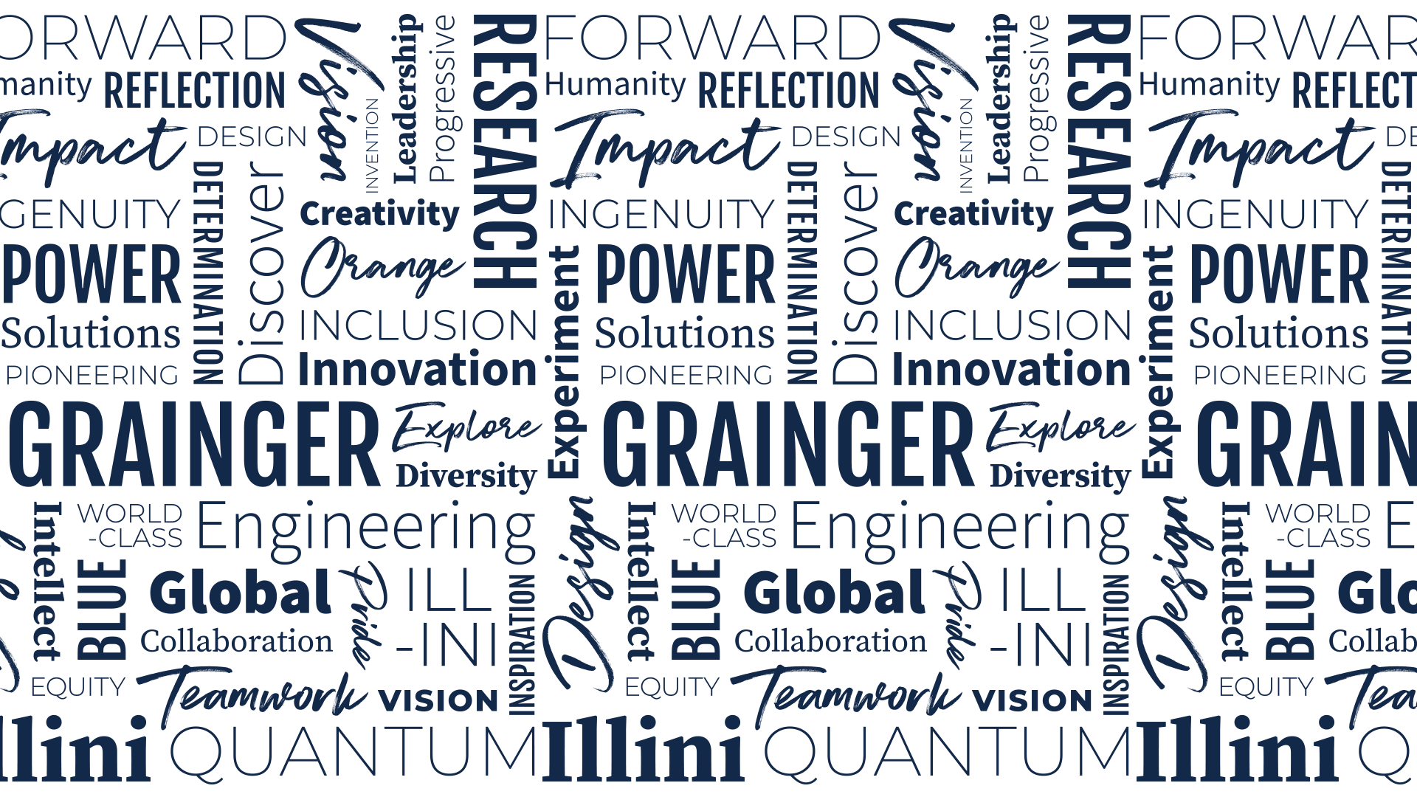


Workshop

Slide 2
What is OpenMC?
Monte Carlo neutron and photon transport code
Open source contribution model, freely available
Extensible for research purposes
Adopt best practices for software development
Ease of installation, minimize third-party dependencies
High performance, scalable on HPC
Fun to use, and a thriving user and developer community!

Slide 3
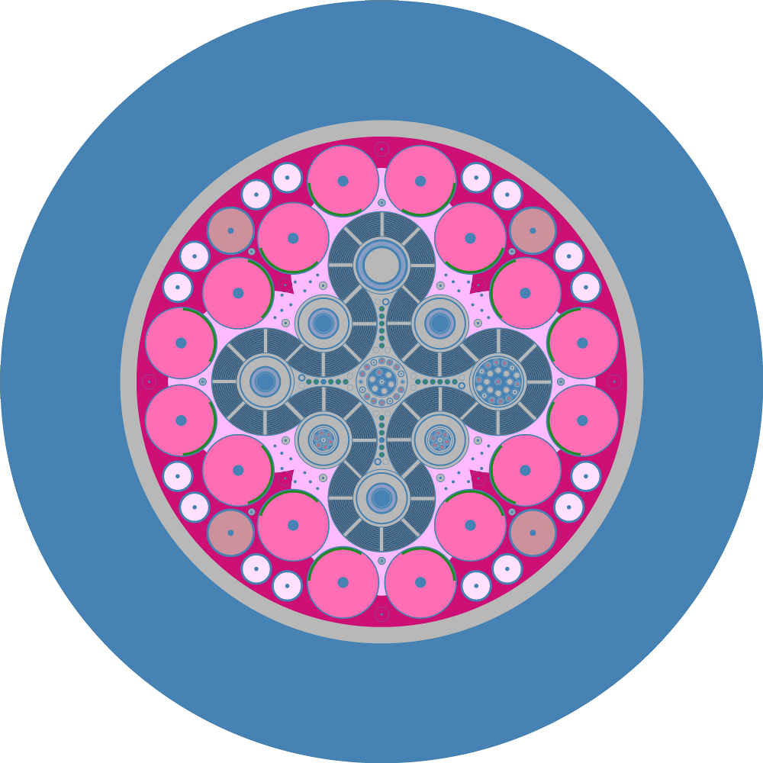
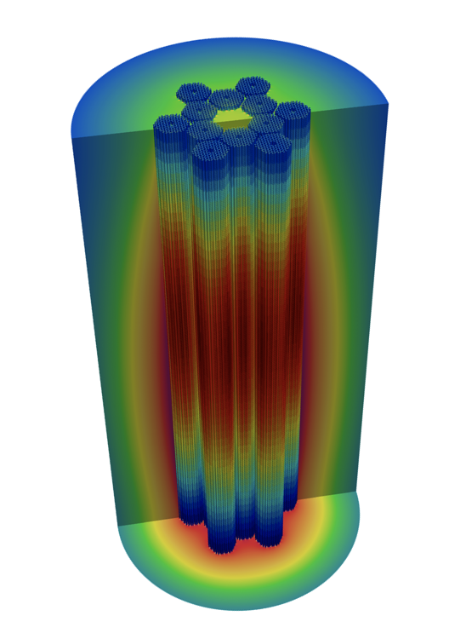
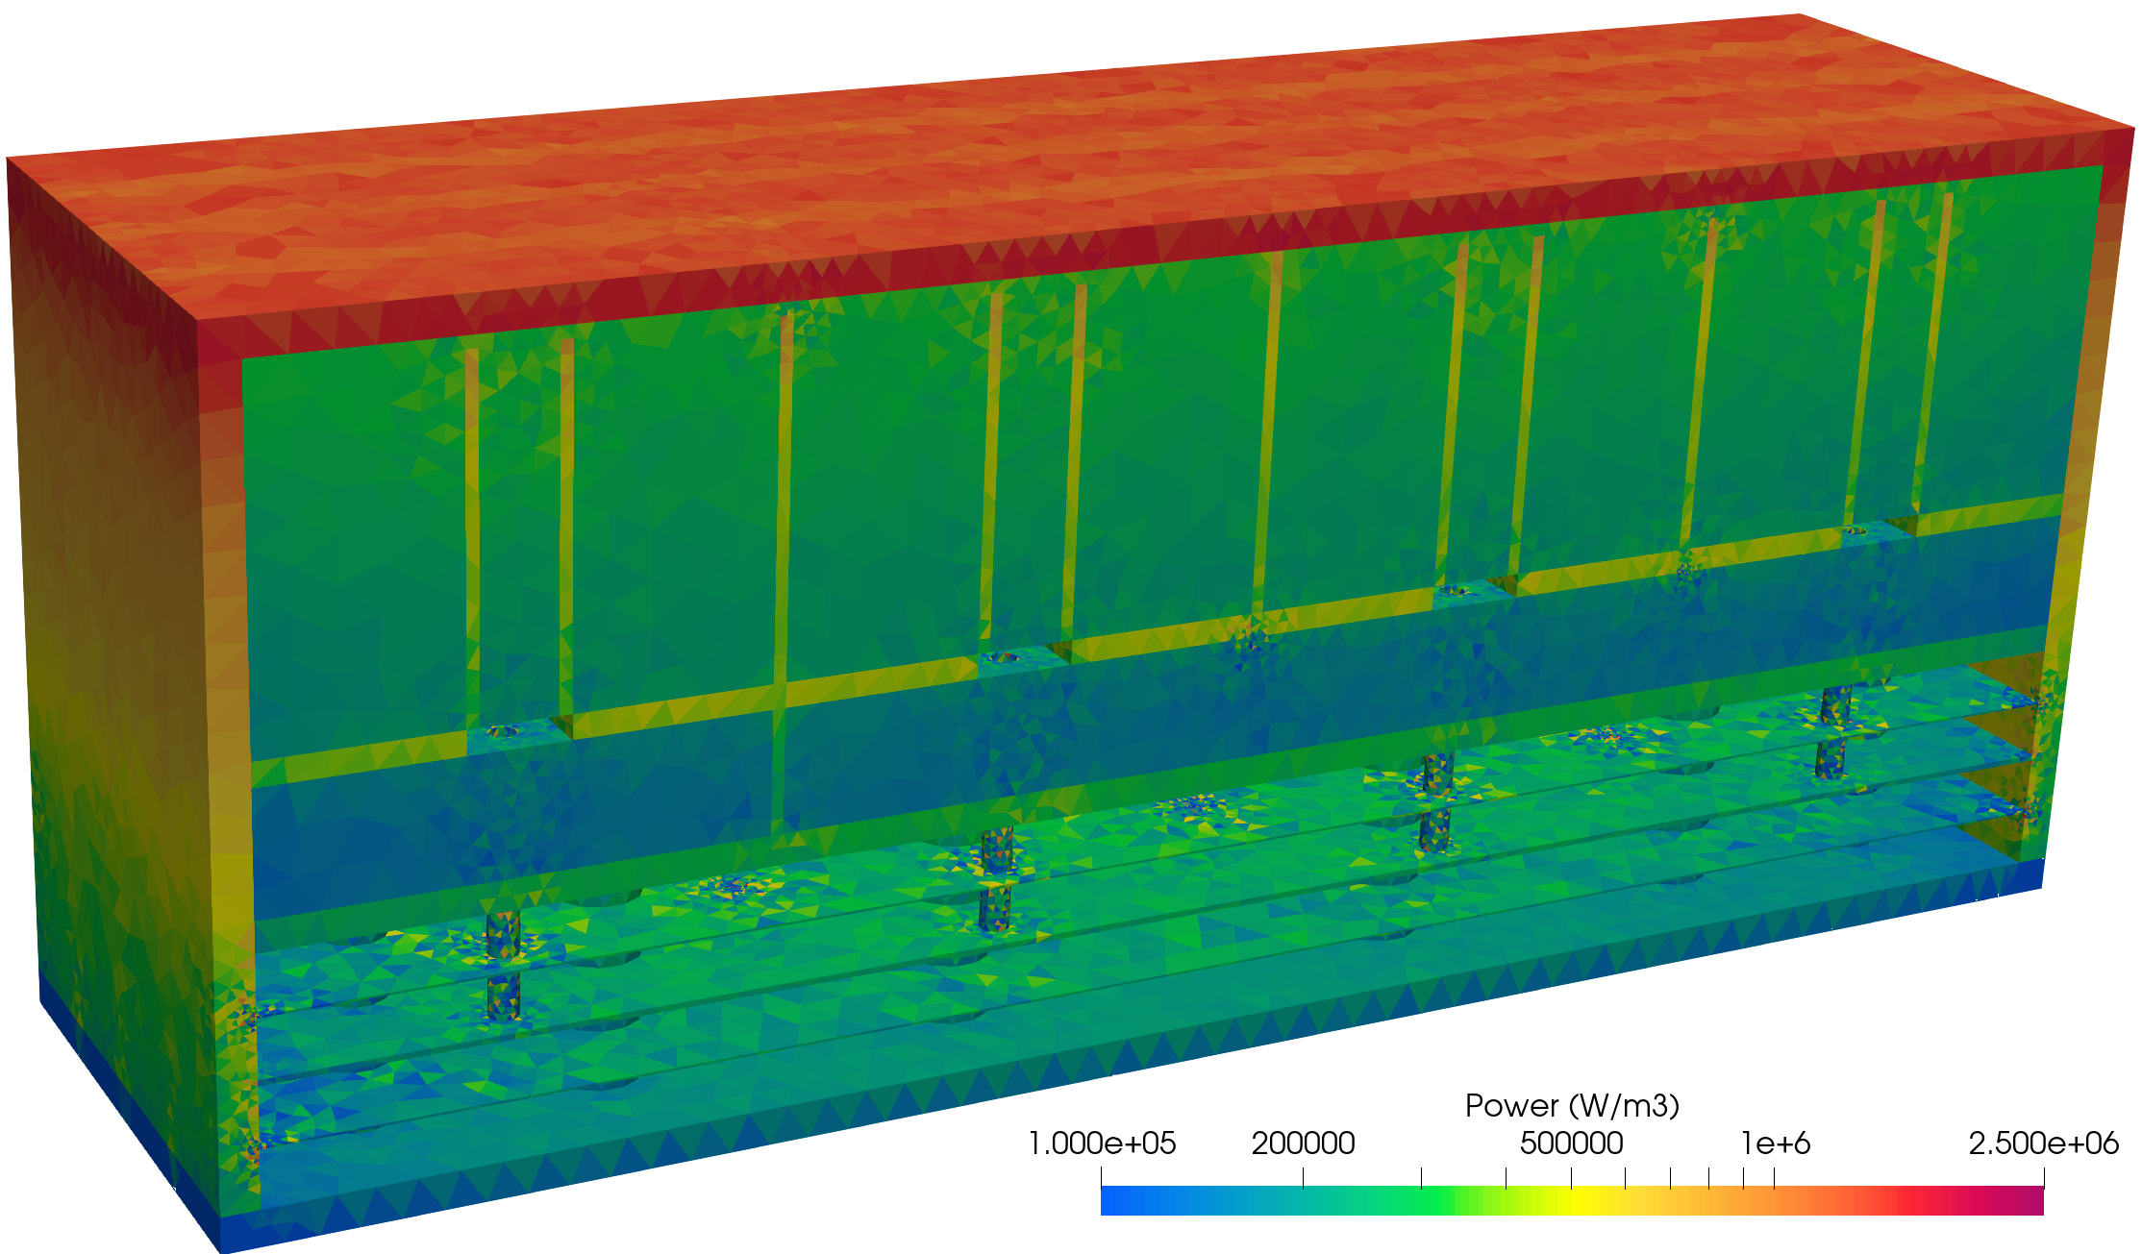
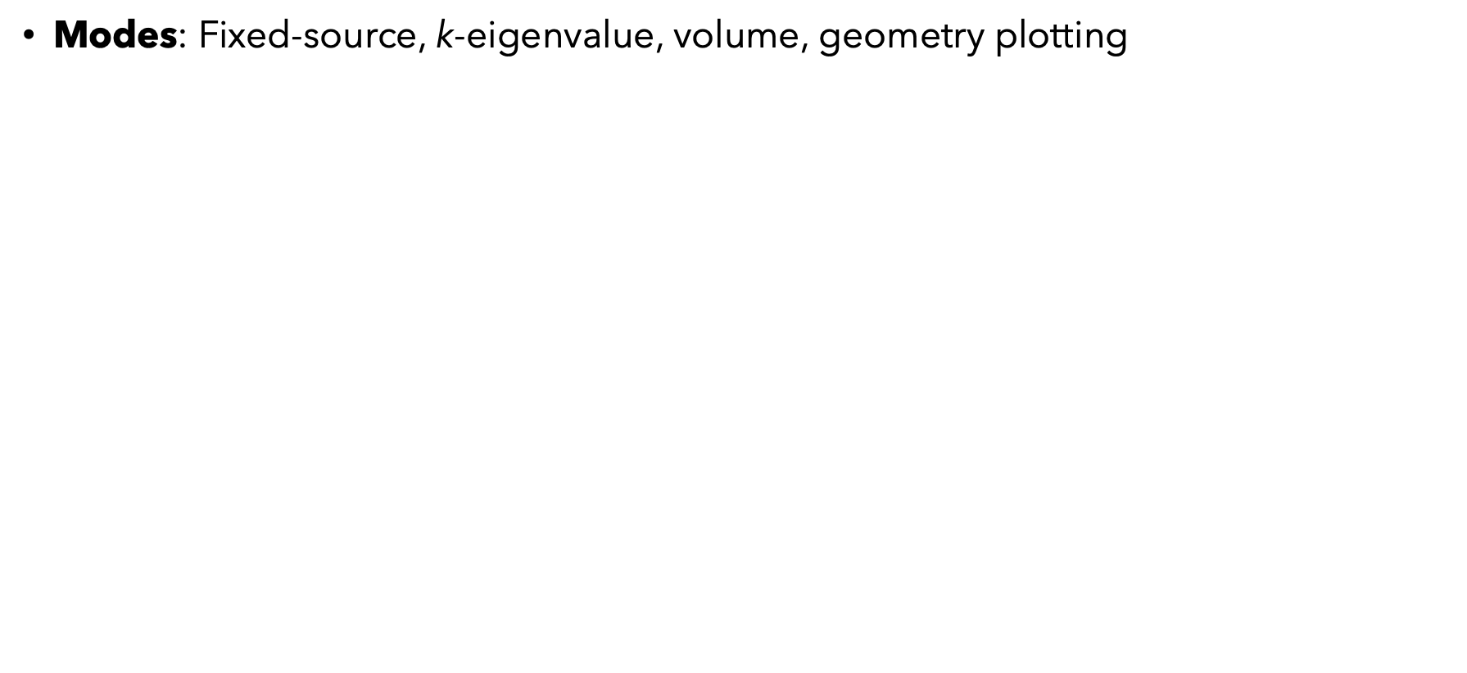
OpenMC Features
Modes: Fixed-source, k-eigenvalue, volume, geometry plotting
Geometry: Constructive solid geometry, CAD surface mesh, unstructured mesh
Tallies: cell tallies, structured mesh tallies, unstructured mesh tallies
Solvers: neutron and photon transport, depletion, stochastic volume calculation
Data: Continuous energy or multigroup $Σ$, multipole for Doppler broadening
Parallelism: hybrid MPI and OpenMP
Fixed source neutron-photon transport
k-eigenvalue neutron transport
built-in geometry plotter
(image credit: OpenMC website)

Slide 4
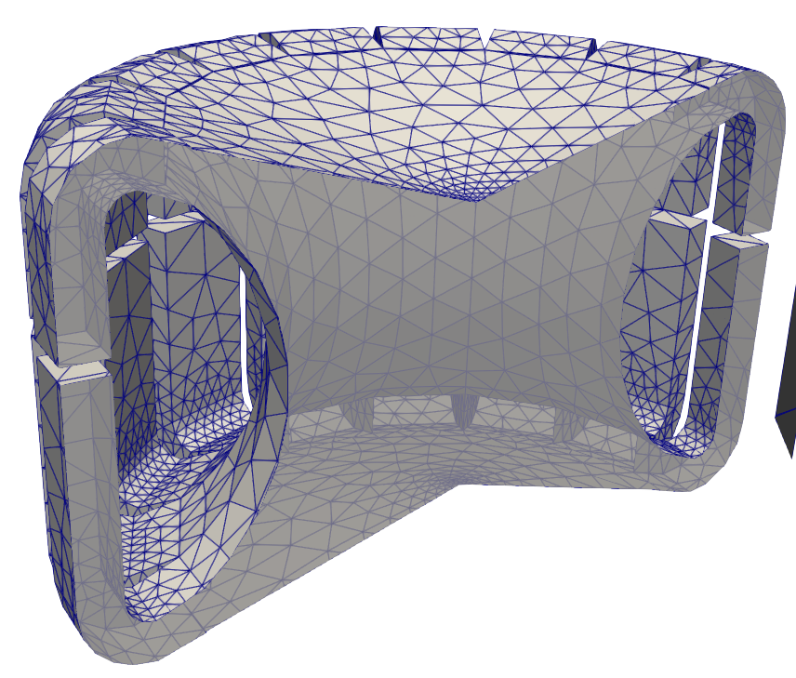
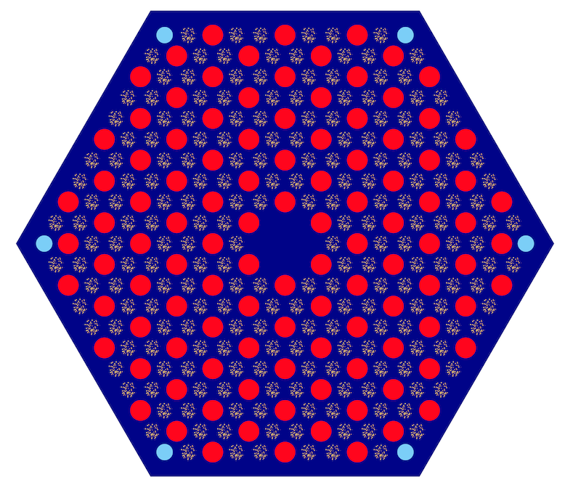
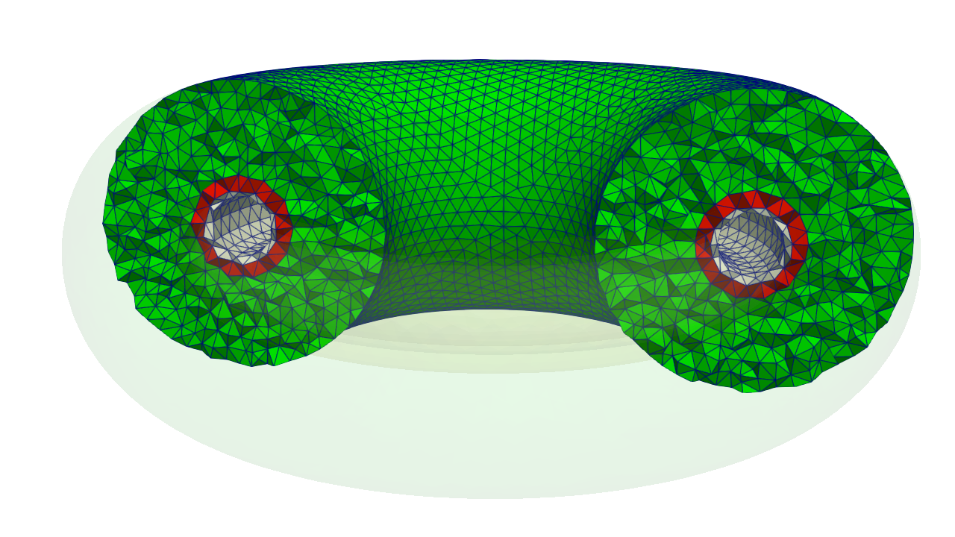
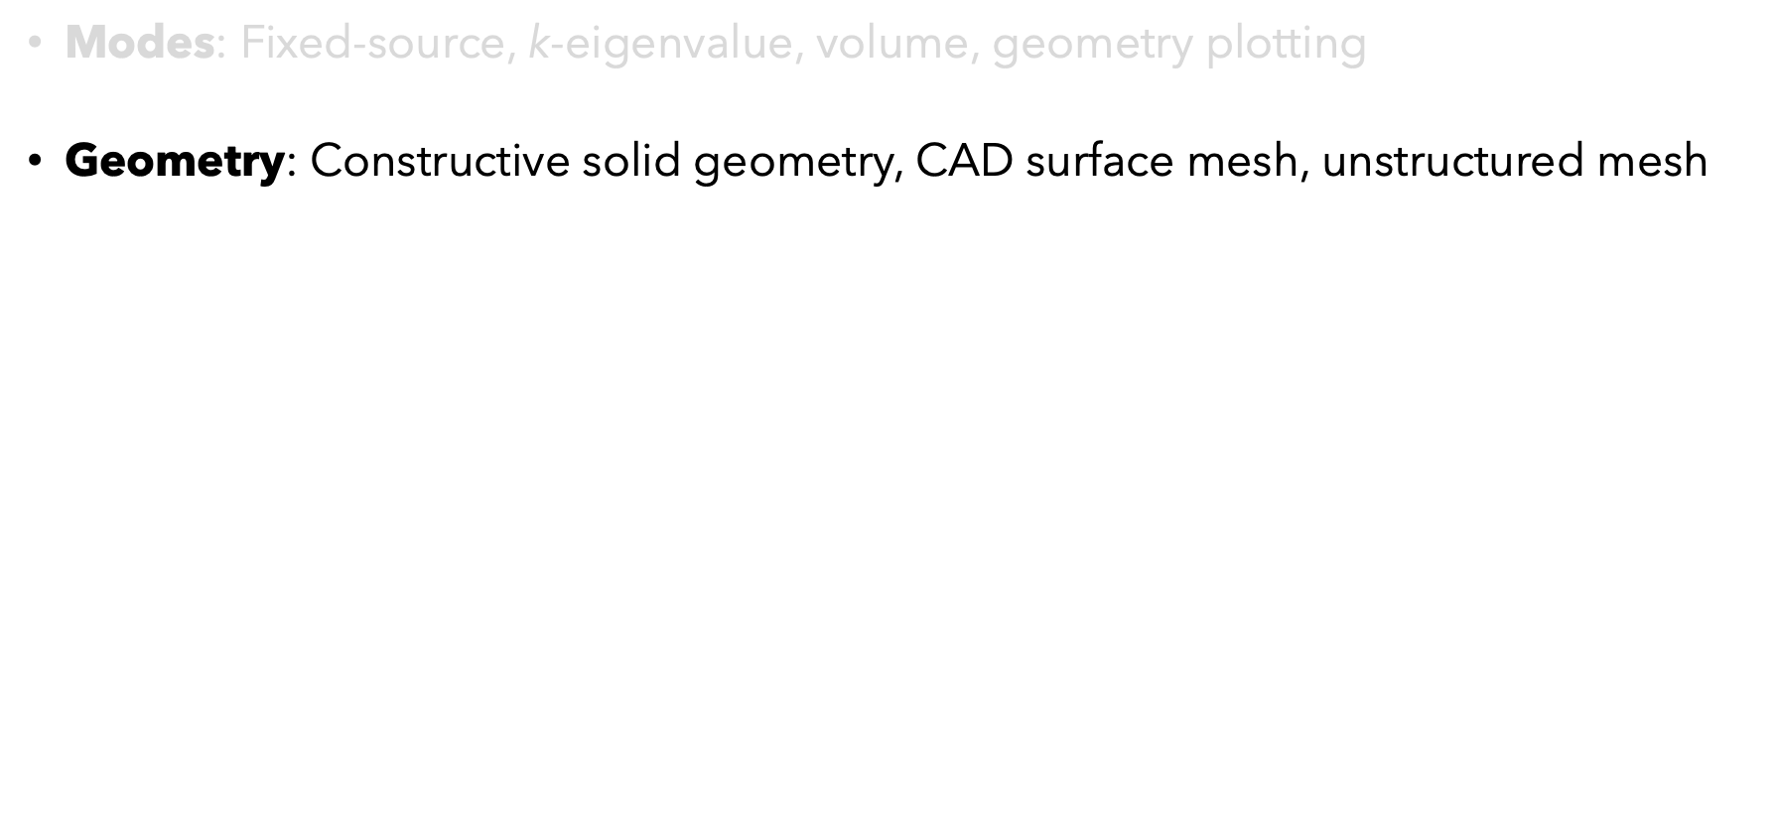
OpenMC Features
Modes: Fixed-source, k-eigenvalue, volume, geometry plotting
Geometry: Constructive solid geometry, CAD surface mesh, unstructured mesh
Tallies: cell tallies, structured mesh tallies, unstructured mesh tallies
Solvers: neutron and photon transport, depletion, stochastic volume calculation
Data: Continuous energy or multigroup $Σ$, multipole for Doppler broadening
Parallelism: hybrid MPI and OpenMP
Constructive Solid Geometry (CSG)
DAGMC CAD surface meshes
libMesh unstructured volume mesh (coming soon)

Slide 5
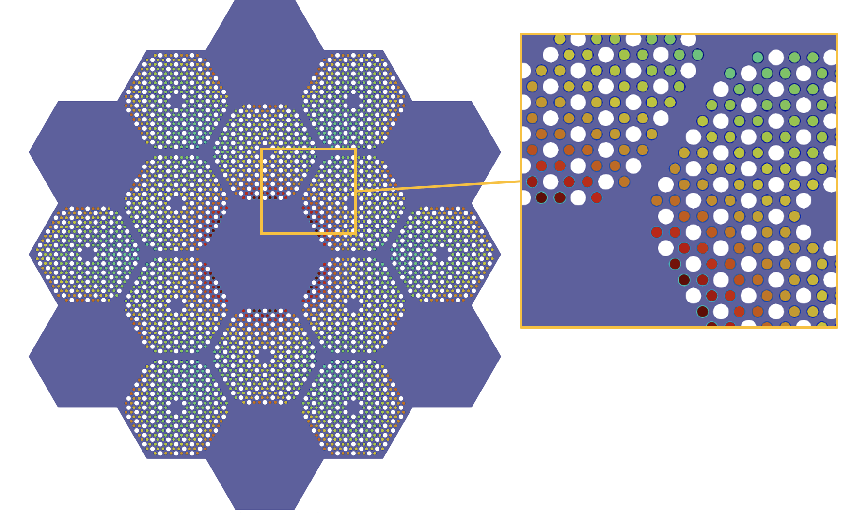
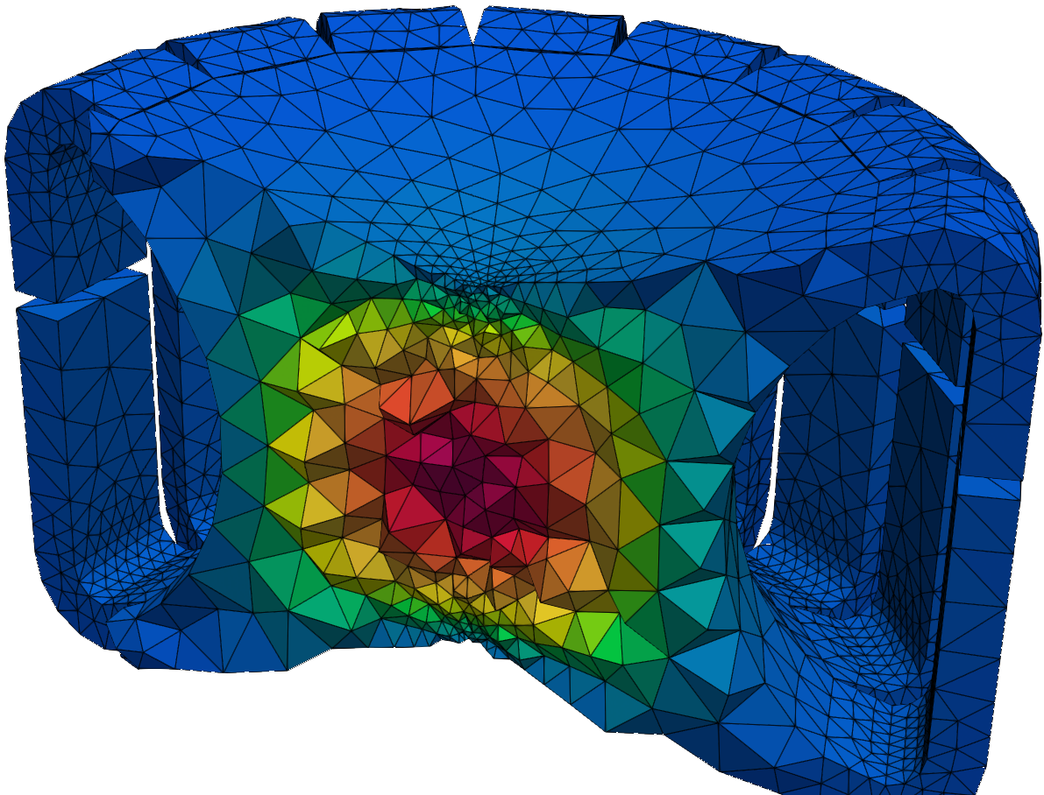
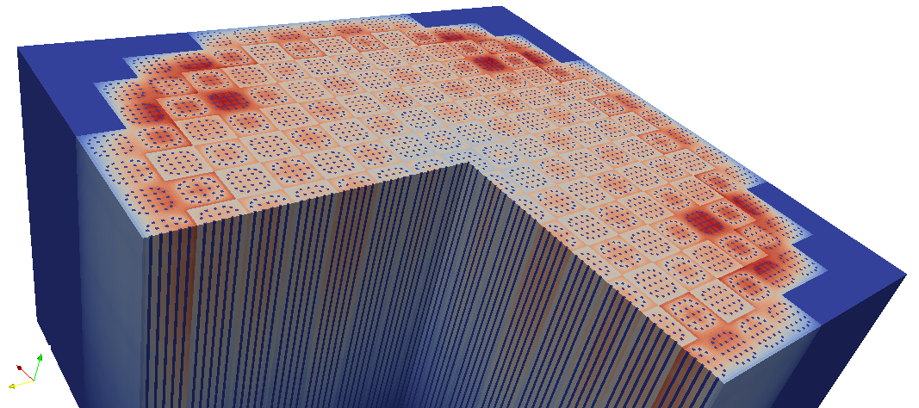
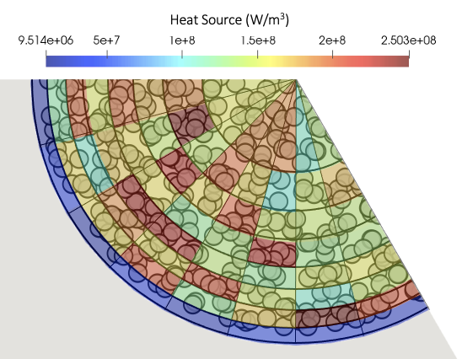
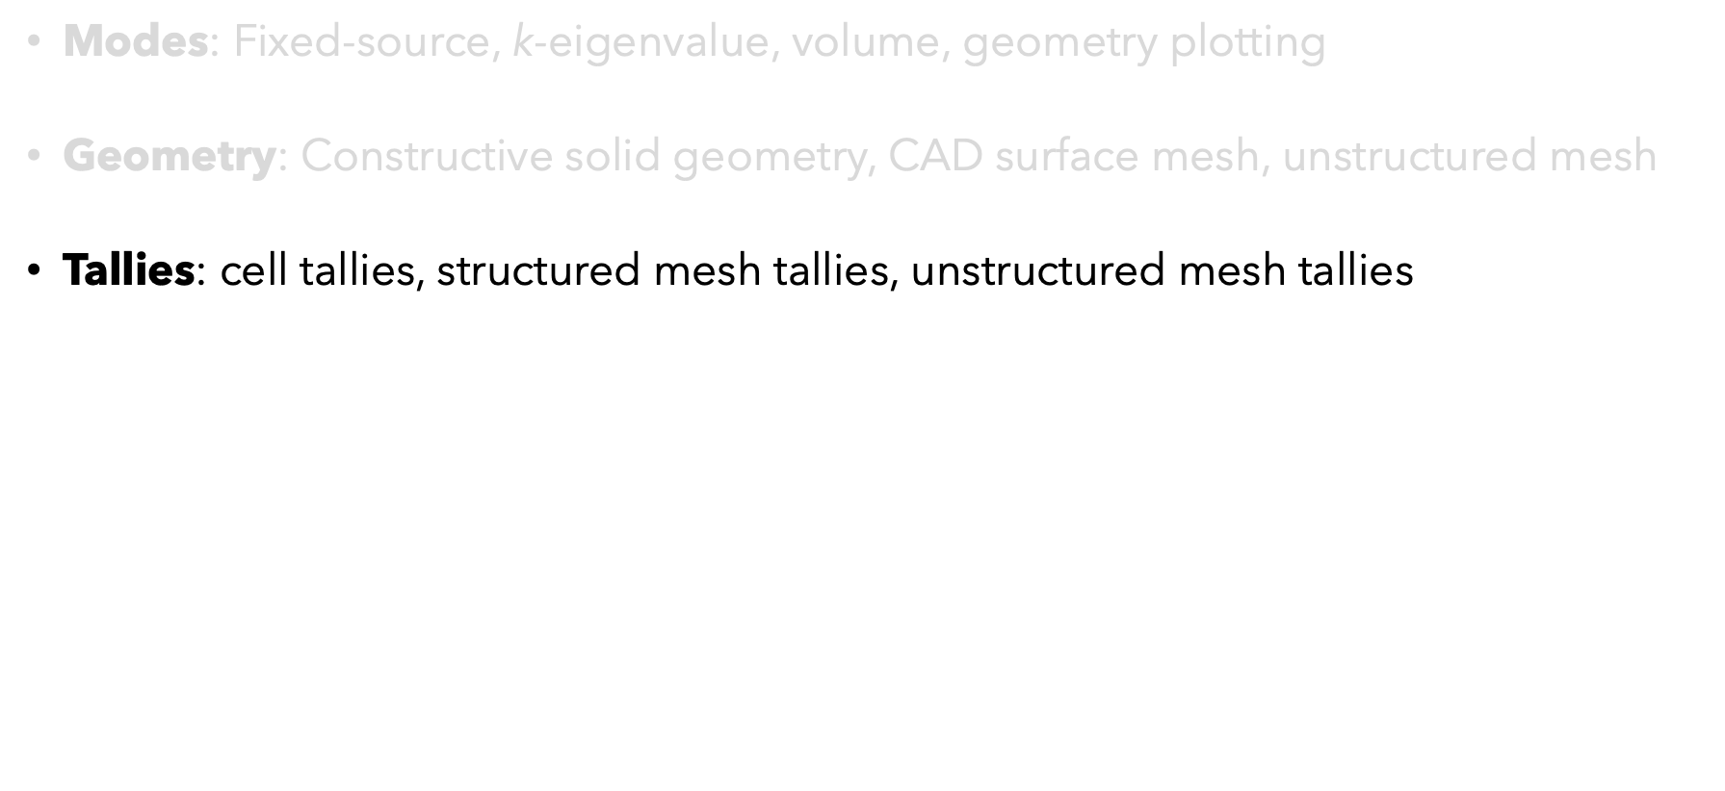
OpenMC Features
Modes: Fixed-source, k-eigenvalue, volume, geometry plotting
Geometry: Constructive solid geometry, CAD surface mesh, unstructured mesh
Tallies: cell tallies, structured mesh tallies, unstructured mesh tallies
Solvers: neutron and photon transport, depletion, stochastic volume calculation
Data: Continuous energy or multigroup $Σ$, multipole for Doppler broadening
Parallelism: hybrid MPI and OpenMP
Cell tally
Structured mesh tally
(image credit: OpenMC website)
Unstructured mesh tally

Slide 6
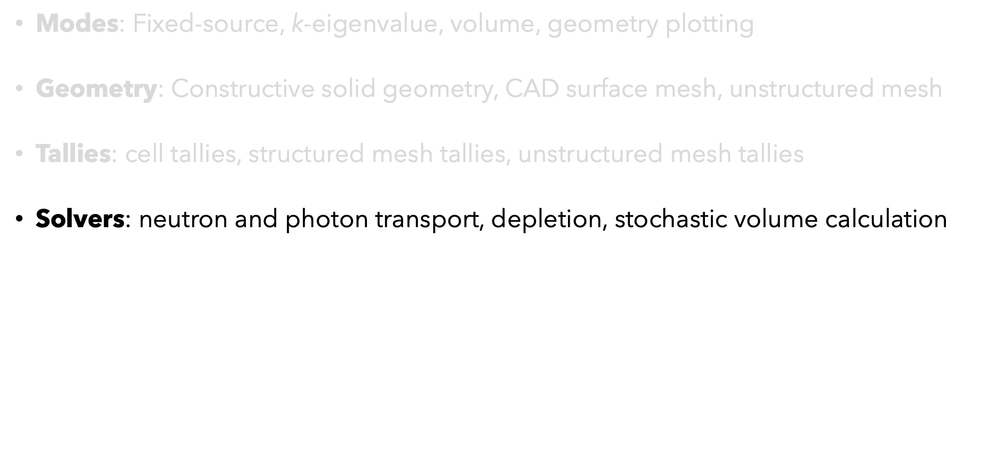
OpenMC Features
Modes: Fixed-source, k-eigenvalue, volume, geometry plotting
Geometry: Constructive solid geometry, CAD surface mesh, unstructured mesh
Tallies: cell tallies, structured mesh tallies, unstructured mesh tallies
Solvers: neutron and photon transport, depletion, stochastic volume calculation
Data: Continuous energy or multigroup $Σ$, multipole for Doppler broadening
Parallelism: hybrid MPI and OpenMP

Slide 7
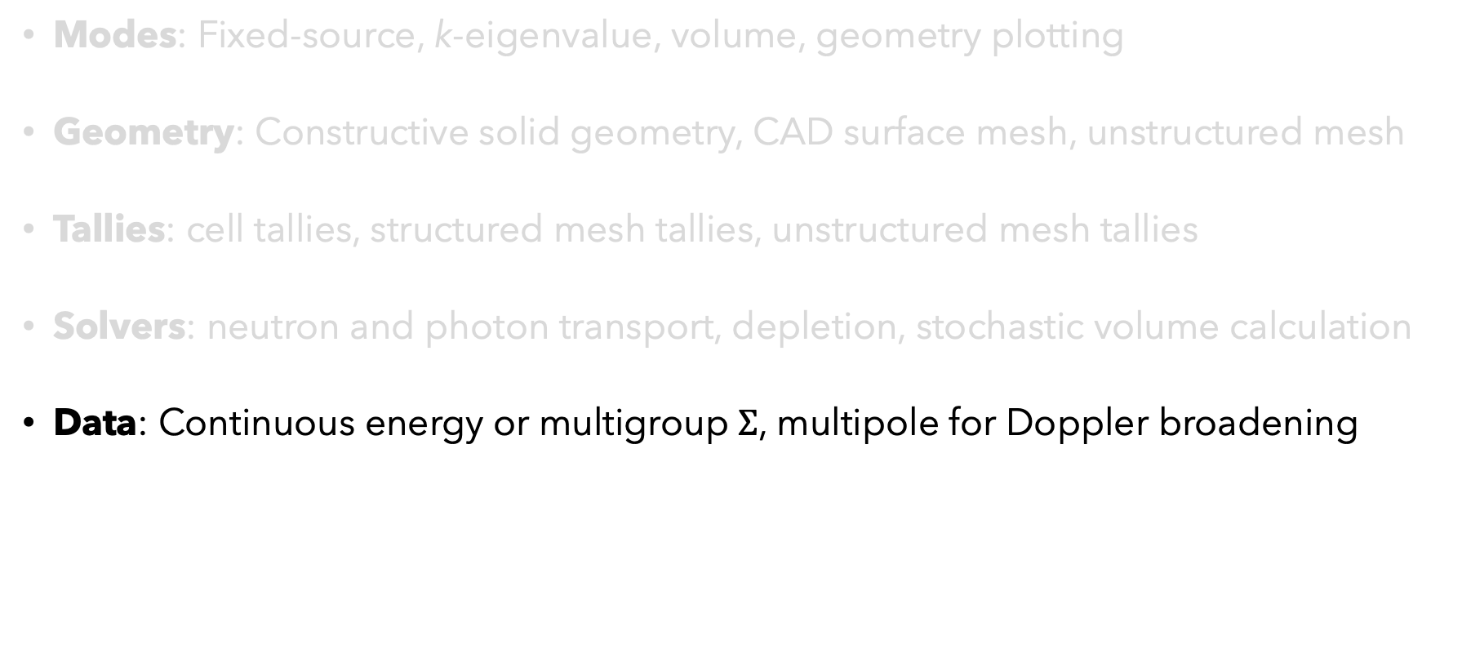
OpenMC Features
Modes: Fixed-source, k-eigenvalue, volume, geometry plotting
Geometry: Constructive solid geometry, CAD surface mesh, unstructured mesh
Tallies: cell tallies, structured mesh tallies, unstructured mesh tallies
Solvers: neutron and photon transport, depletion, stochastic volume calculation
Data: Continuous energy or multigroup $Σ$, multipole for Doppler broadening
Parallelism: hybrid MPI and OpenMP

Slide 8
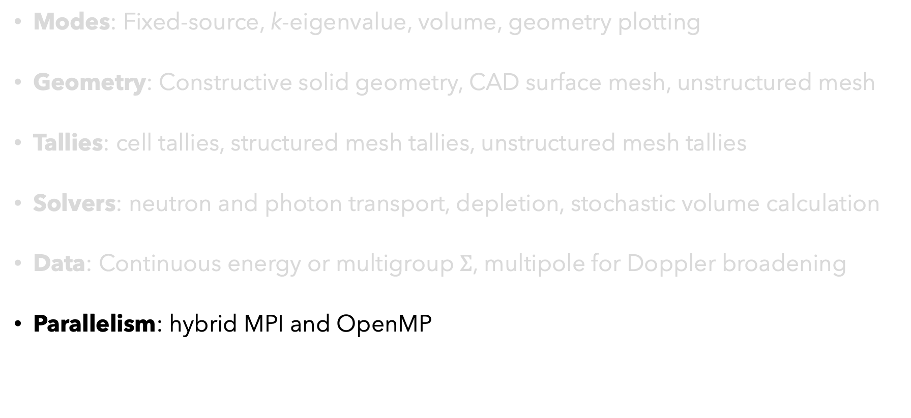
OpenMC Features
Modes: Fixed-source, k-eigenvalue, volume, geometry plotting
Geometry: Constructive solid geometry, CAD surface mesh, unstructured mesh
Tallies: cell tallies, structured mesh tallies, unstructured mesh tallies
Solvers: neutron and photon transport, depletion, stochastic volume calculation
Data: Continuous energy or multigroup $Σ$, multipole for Doppler broadening
Parallelism: hybrid MPI and OpenMP

Slide 9
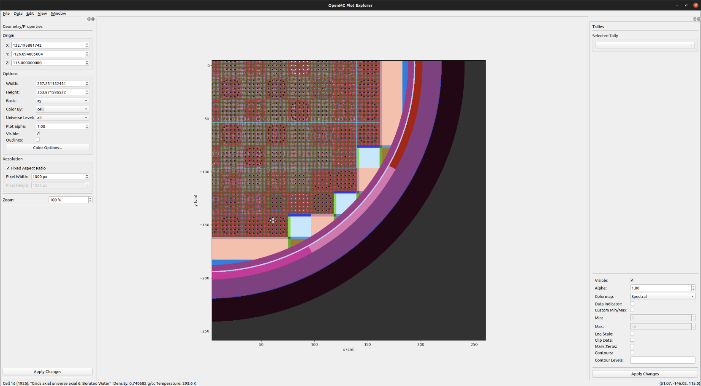
What makes OpenMC unique?
Programming interfaces: C/C++ and python APIs
Nuclear data interfaces and representation
Tally abstractions
Parallel performance
Development workflow and governance
CMake build system for portability
git version control
GitHub code hosting, issue tracking
Robust regression test suite
Plotting GUI
https://github.com/openmc-dev/plotter

Slide 10
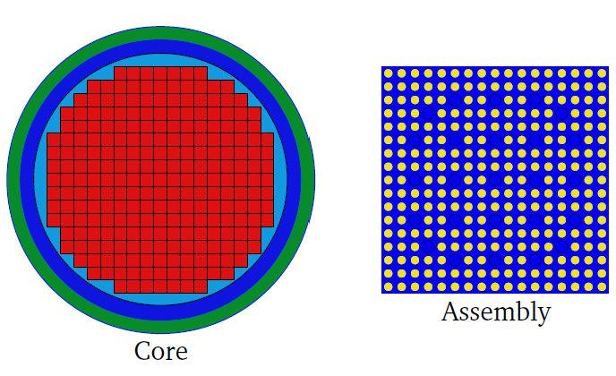
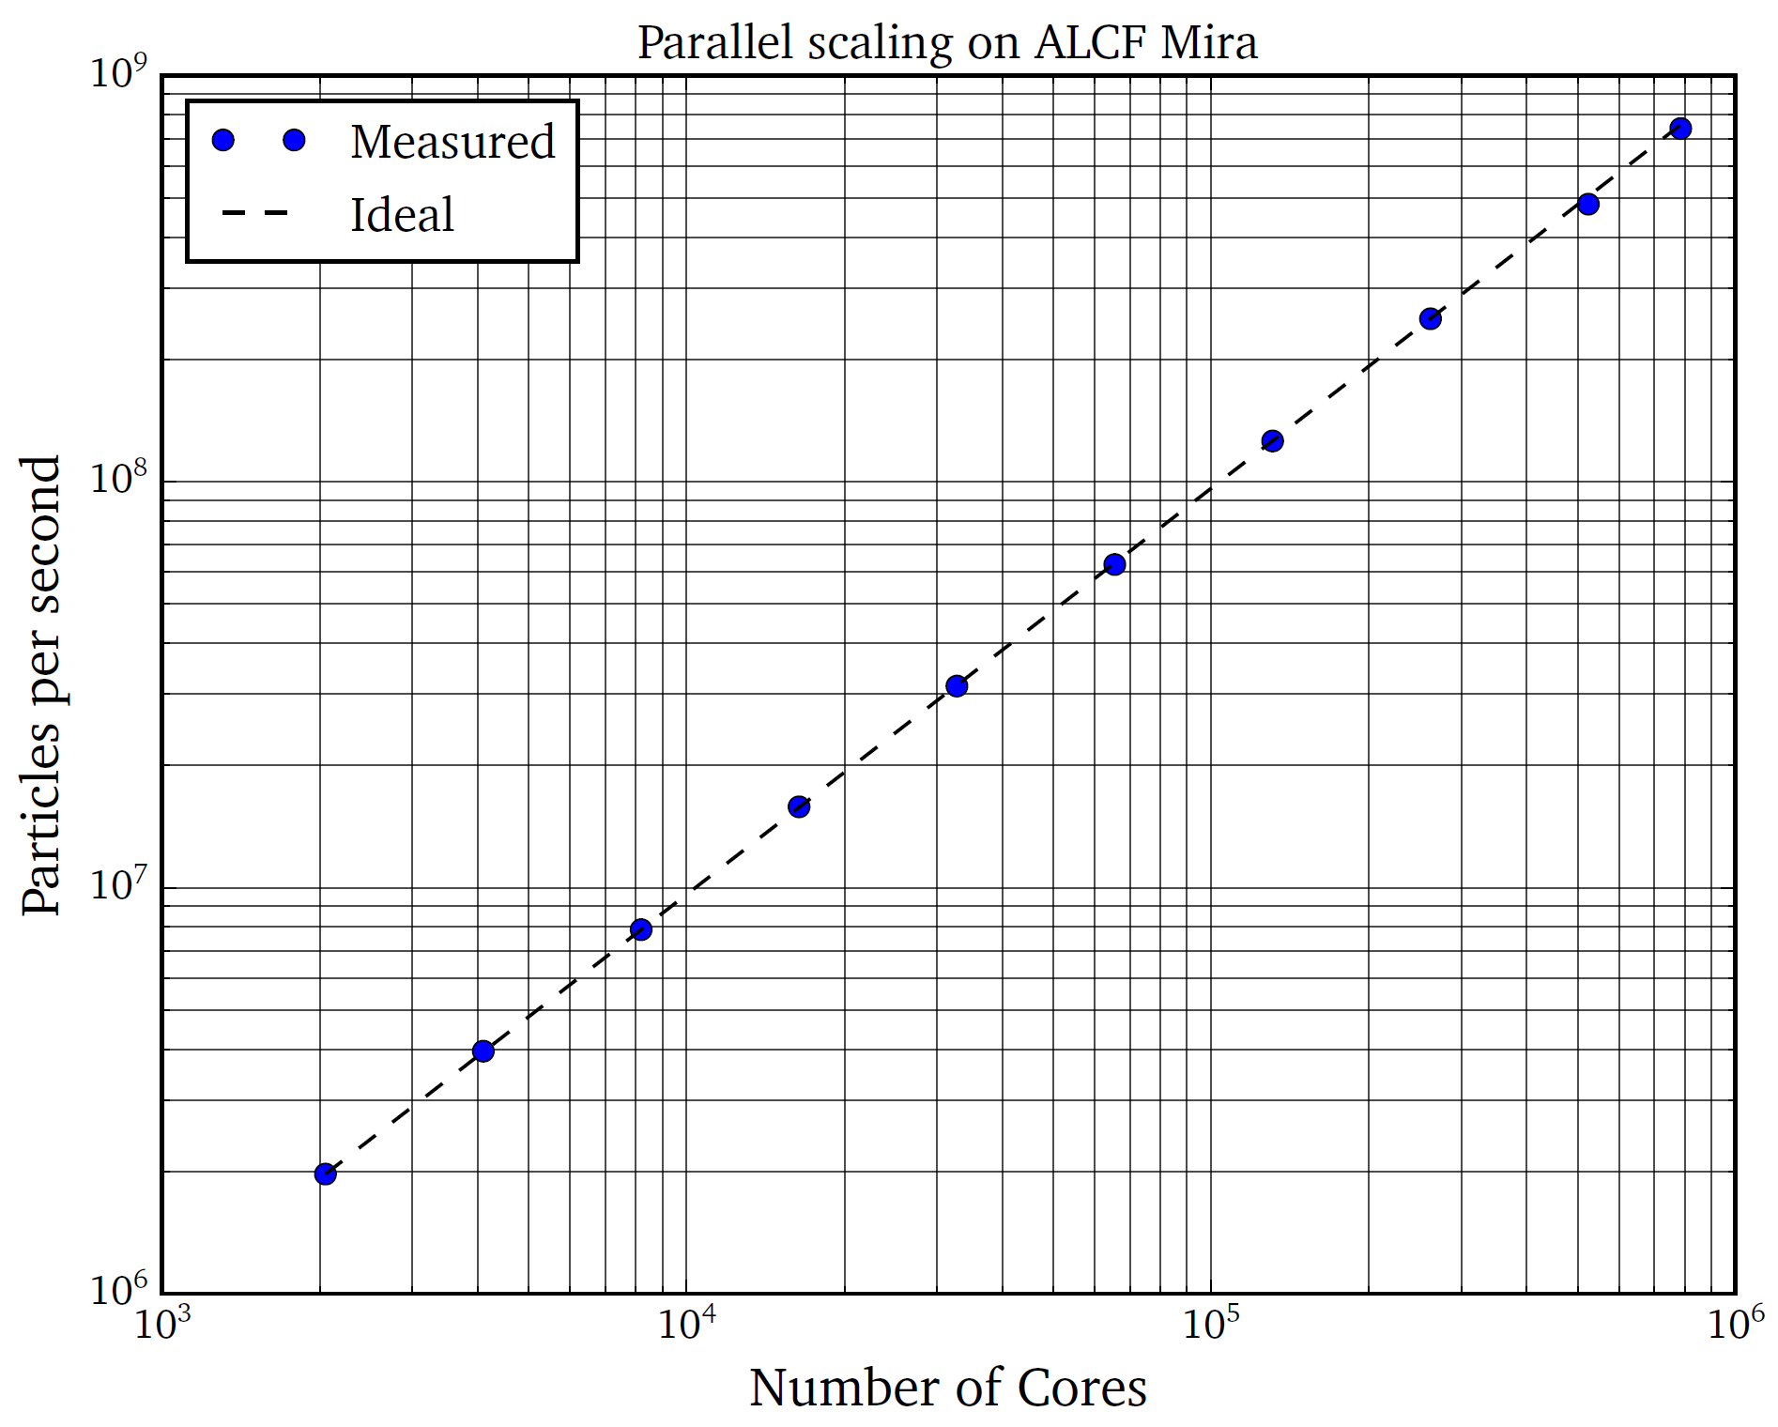
Parallel Performance
ALCF Mira Supercomputer
49,152 nodes
786,432 cores
3,145,728 threads
(image credit: P. Romano)

Slide 11
Resources
Code (https://github.com/openmc-dev/openmc)
Documentation (https://docs.openmc.org/)
Tutorials: (https://github.com/openmc-dev/openmc/wiki/Example-Jupyter-Notebooks)
Data (https://openmc.org)
Forum: (https://openmc.discourse.group)

Slide 12
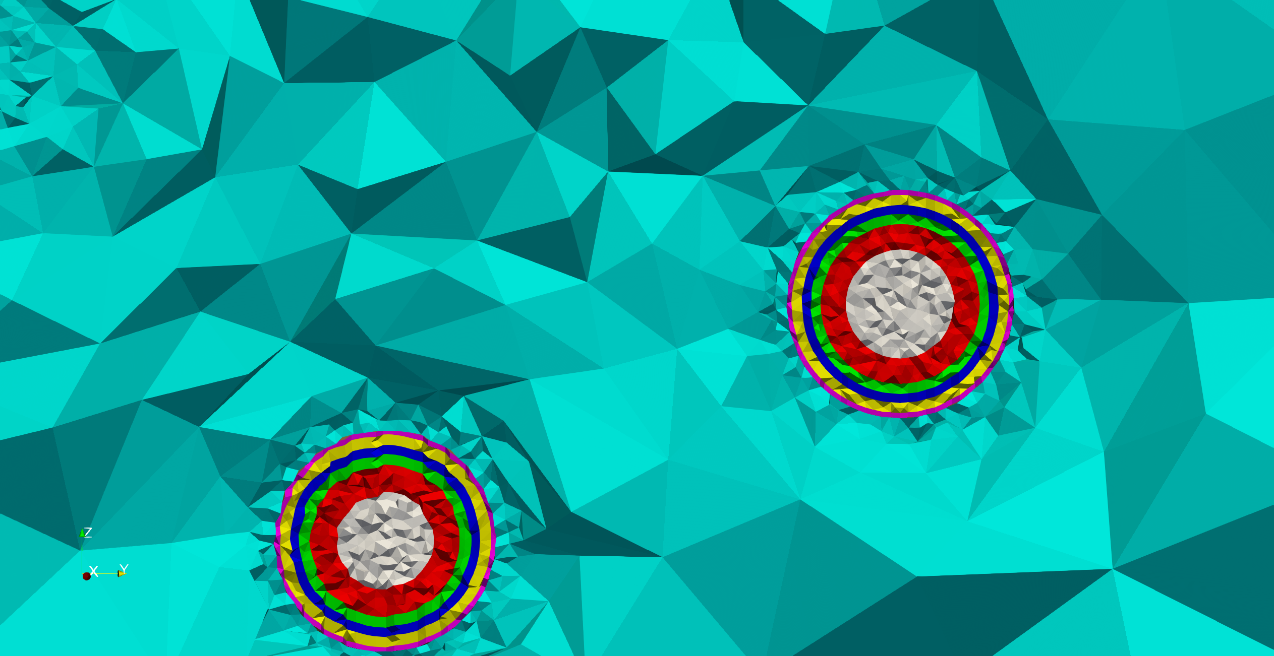
Geometry Basics
There are many forms of computational geometry:
Volumetric meshes (common in other areas of physics)
Image courtesy of A. Hegazy

Slide 13
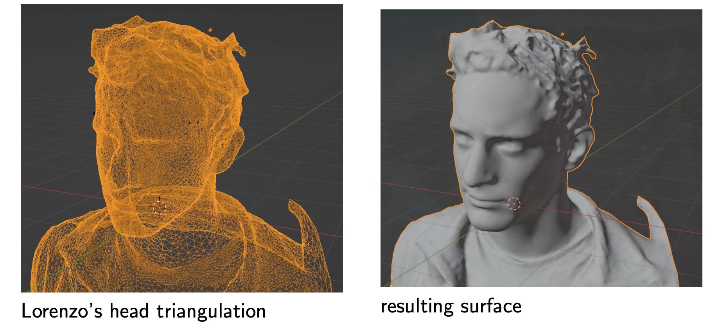
Geometry Basics
There are many forms of computational geometry:
Volumetric meshes (common in other areas of physics)
Surface meshes (e.g., video game characters)
Image courtesy of G. Ridley

Slide 14
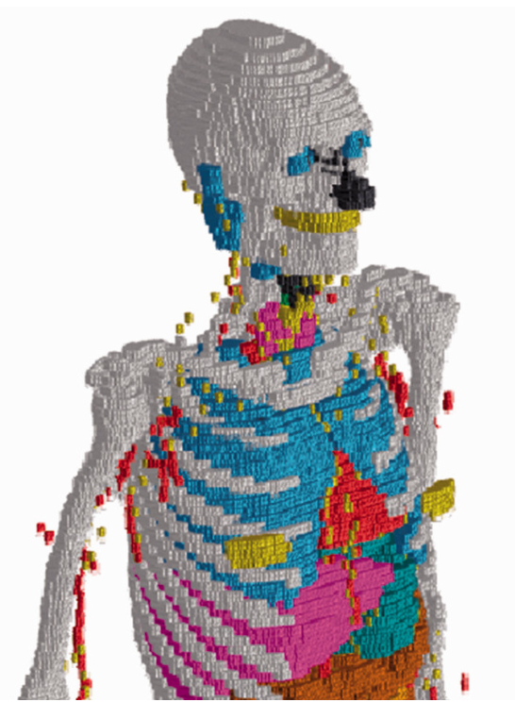
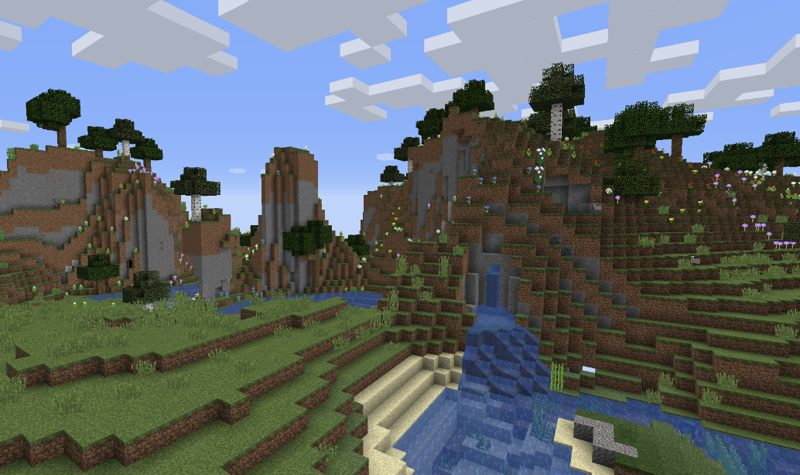
Geometry Basics
There are many forms of computational geometry:
Volumetric meshes (common in other areas of physics)
Surface meshes (e.g., video game characters)
Voxels (e.g., Minecraft)

Slide 15
Geometry Basics
There are many forms of computational geometry:
Volumetric meshes (common in other areas of physics)
Surface meshes (e.g., video game characters)
Voxels (e.g., Minecraft)
Constructive Solid Geometry (CSG), a.k.a. combinatorial geometry

Slide 16
CSG Example
z
y
5
x
x
-2
2

Slide 17
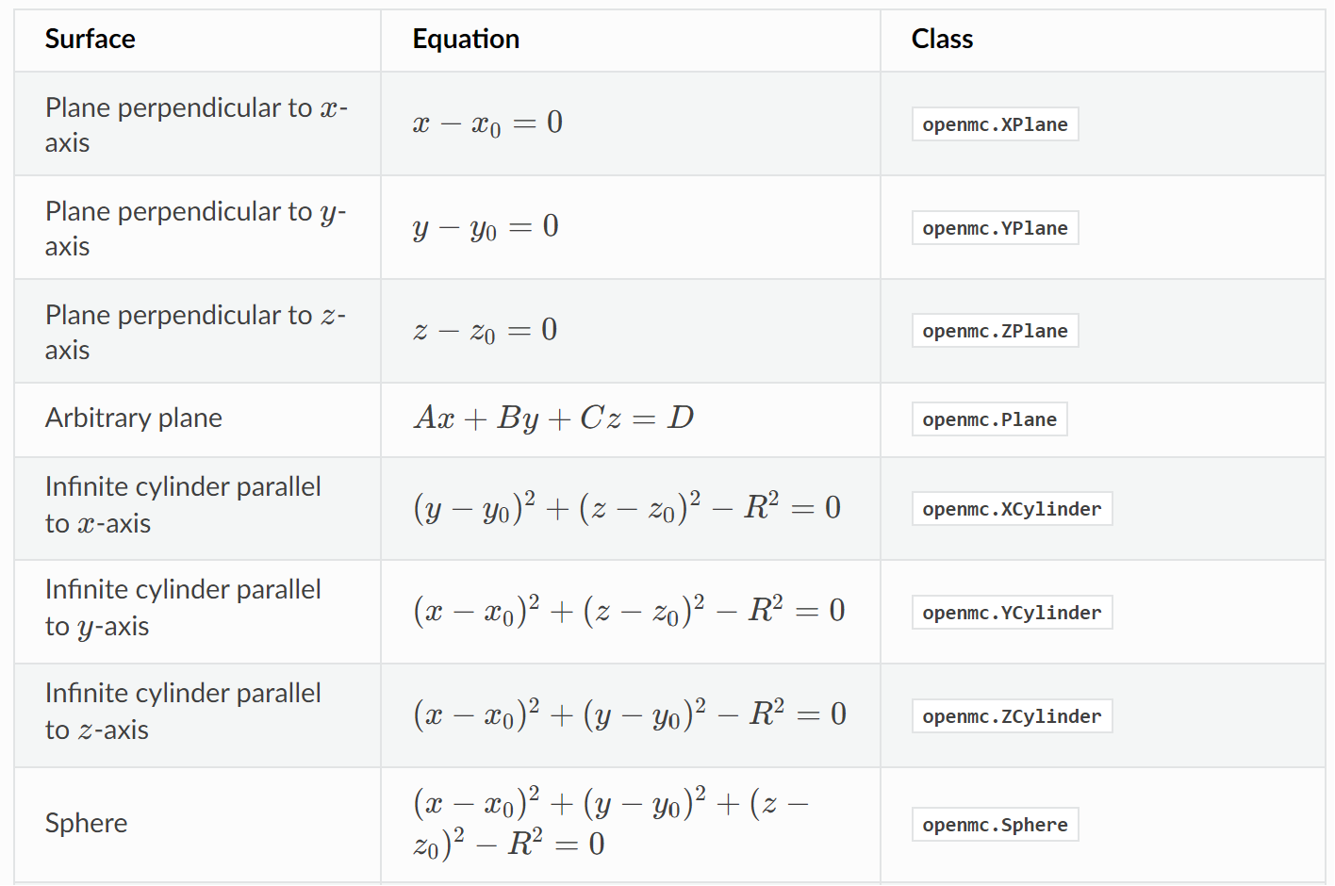
Surfaces
z
top
5
cylinder
bottom
x
-2
2
top = openmc.ZPlane(z0=5)
bottom = openmc.ZPlane(z0=0)
cylinder = openmc.ZCylinder(r=2, x0=0, y0=0)

Slide 18
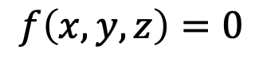
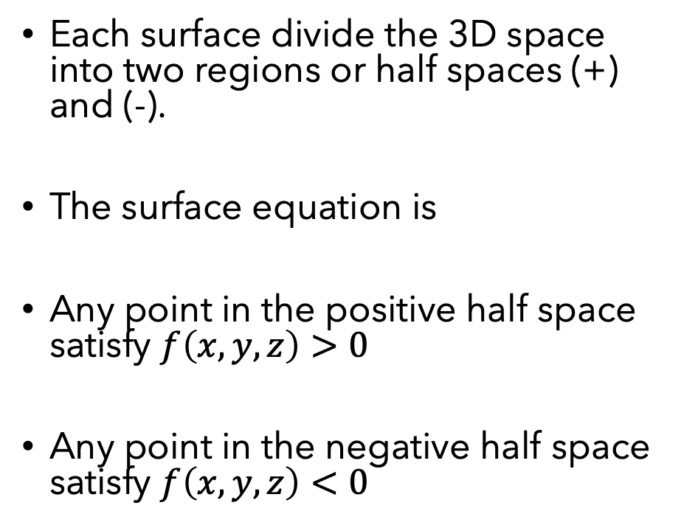
Regions
-cylinder
+bottom
+top
+cylinder
+cylinder
Each surface divide the 3D space into two regions or half spaces (+) and (-).
The surface equation is
Any point in the positive half space satisfy $f\left(x,y,z\right)>0$
Any point in the negative half space satisfy $f\left(x,y,z\right)<0$
-top
top
$$f\left(x,y,z\right)=0$$
cylinder
bottom
-bottom

Slide 19
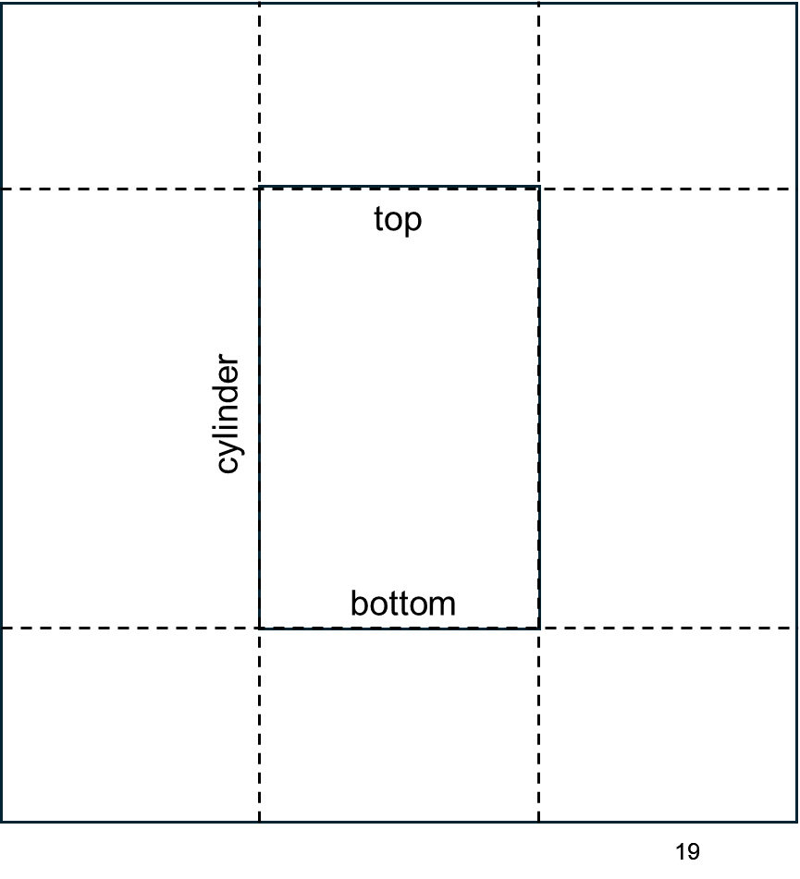
Cells
Define cells using intersections and unions of regions
fuel
fuel = openmc.Cell(fill = fuel)
fuel.region = -top & +bottom & -cylinder
vacuum = openmc.Cell(fill = NONE)
vacuum.region = +top | -bottom | +cylinder

Slide 20
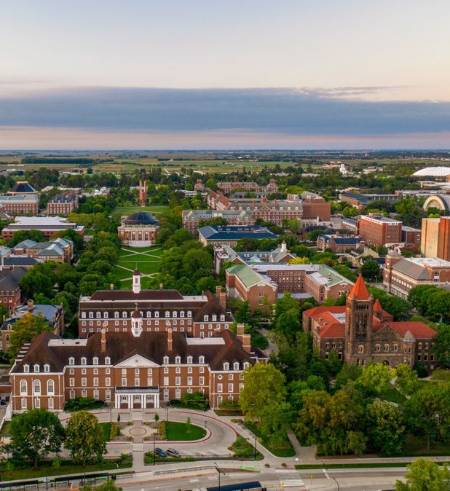
University of Illinois

Slide 21
OpenMC Research at University of Illinois
Mission: Leverage advanced computing to accelerate nuclear energy technologies
Computational methods for radiation transport and thermal-hydraulics
Multiscale and multiphysics algorithms
High performance computing
Applications to fission reactor design, safety analysis, fusion device engineering, shielding, and more …

Slide 22
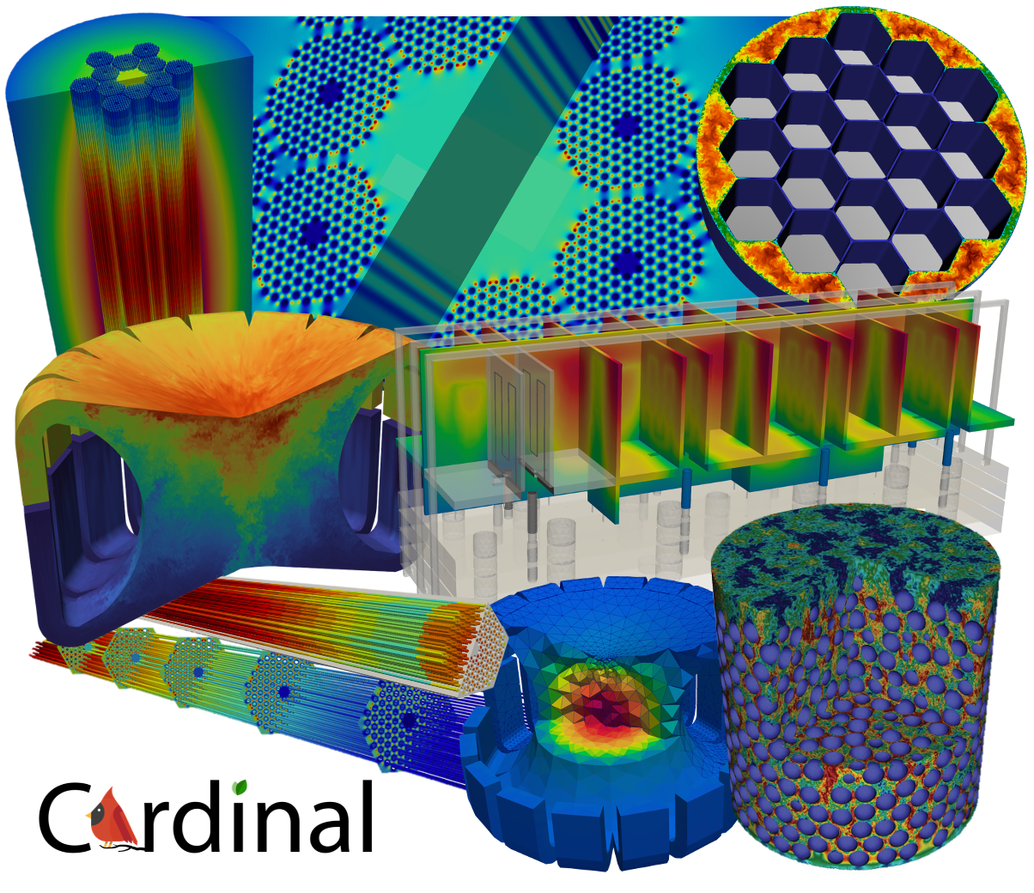

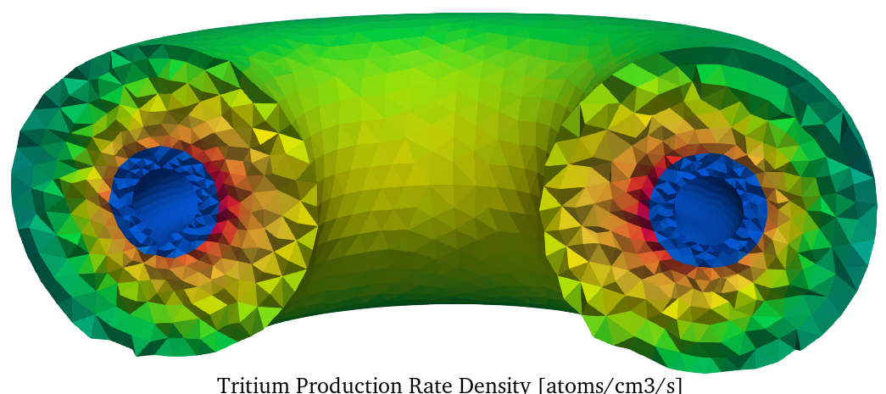
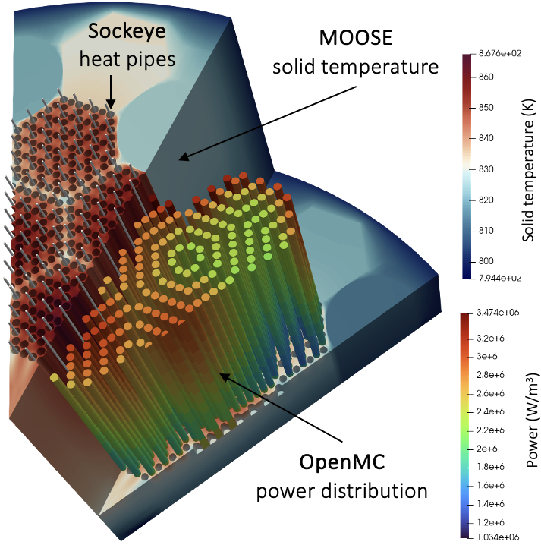
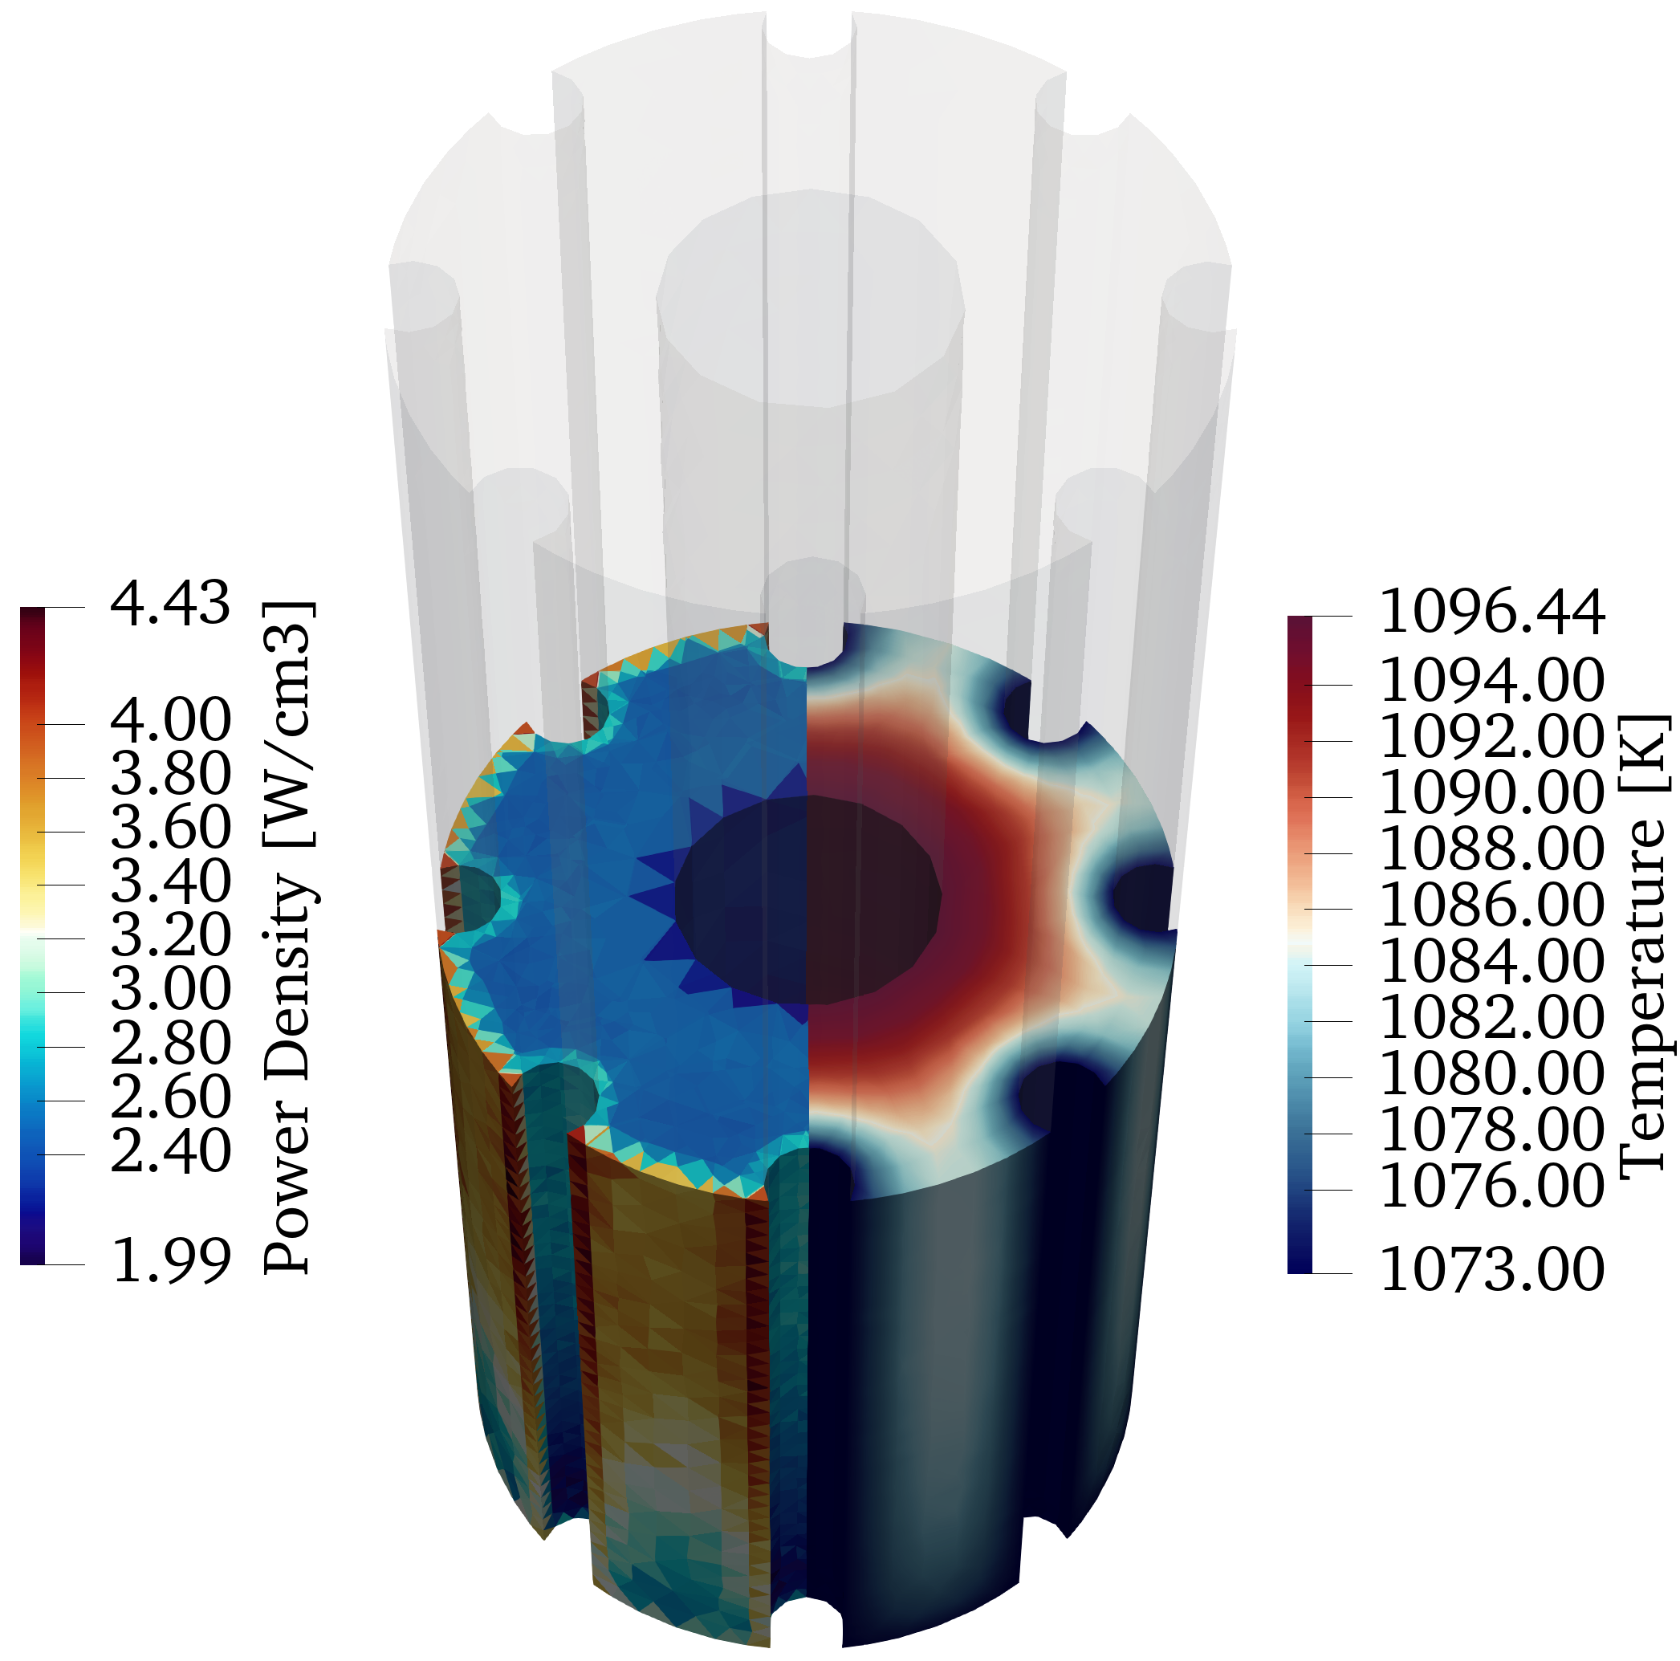
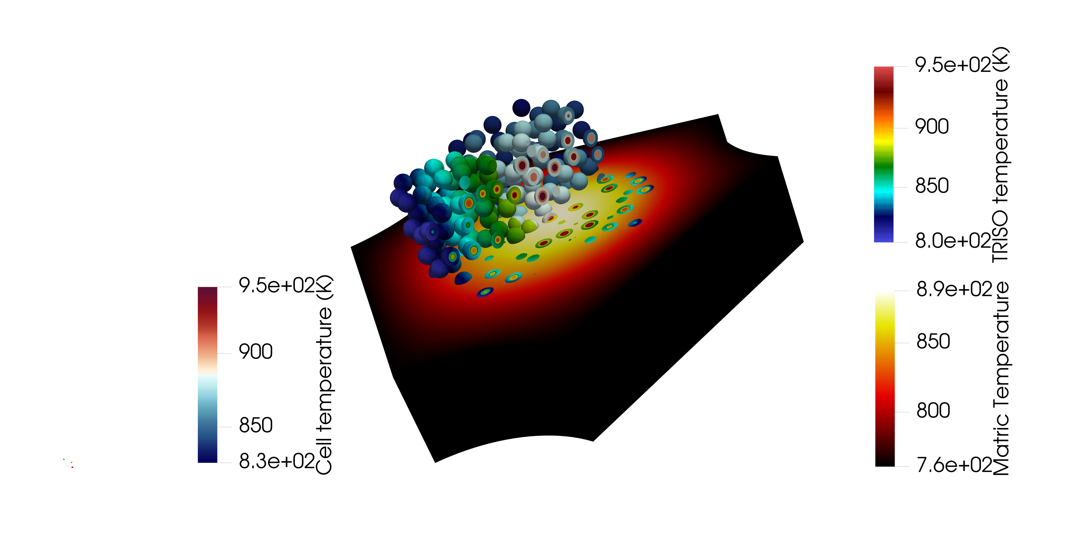
OpenMC Research at University of Illinois
Open-source multiphysics coupling of OpenMC and NekRS with MOOSE (https://cardinal.cels.anl.gov/)
Couple OpenMC to anything in MOOSE!
Plug-and-play multiphysics feedback
Supports CSG and CAD geometry, cell/mesh tallies
Advanced visualization
Fusion devices
TRISO fuels
Heat pipe microreactors

